Slide 1


Data Céilí 2025 Hands on with Fabric: end-to-end data engineering
Luke Moloney
Principal Program Manager
Microsoft Fabric PG
Frederic Van Kelecom
Senior Program Manager
Microsoft Fabric PG

Slide 2
Introduction, setup and overview of Fabric

Slide 3
Agenda
09:00 am – 09:30 am | Introduction, setup and overview of Fabric Analytics platform
09:30 am – 10:45 am | Ingest data using Fabric Data Factory, Copy Job and Mirroring
10:45 am – 11:00 am | Break
11:00 am – 12:00 pm | Transform data using Spark and SQL
12:00 pm – 01:00 pm | Lunch break
01:00 pm – 02:00 pm | Query data using Fabric Data Agents and interact with OneLake
02:00 pm – 02:15 pm | Break
02:15 pm – 03:45 pm | Monitoring, admin, capacities and automation
03:45 pm – 04:00 pm | Break
04:00 pm – 05:00 pm | Wrap up and Q&A

Slide 4
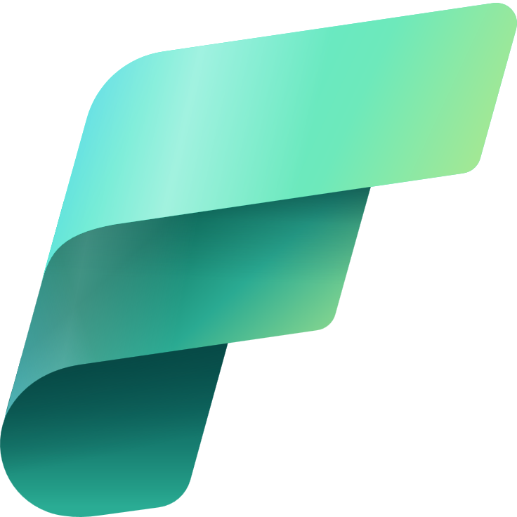

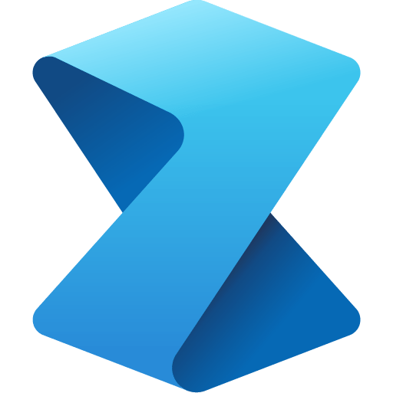
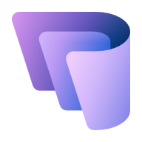

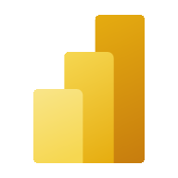




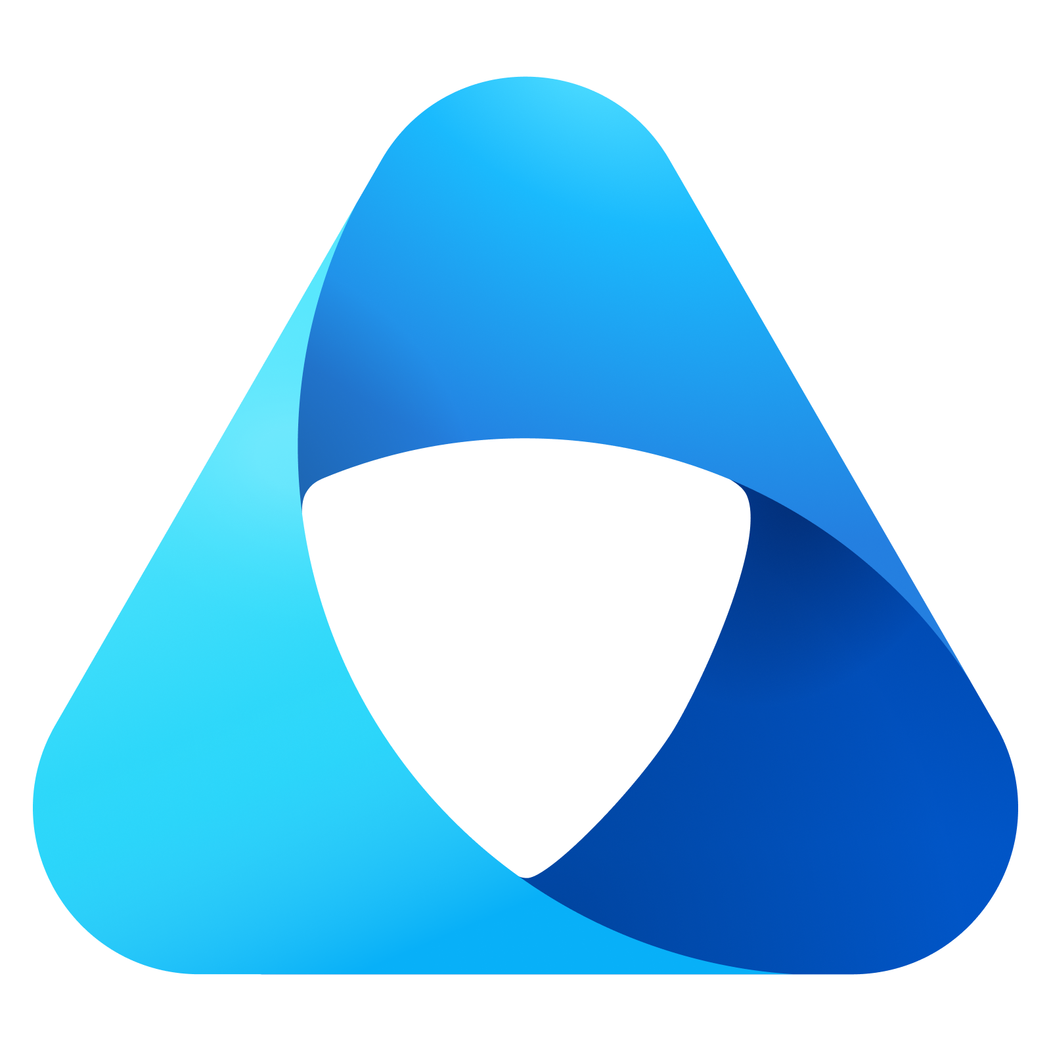
Microsoft Fabric
The unified data platform for AI transformation
Data
Factory
Analytics
Databases
Real-Time Intelligence
Power BI
Industry Solutions
Partner Workloads
AI
OneLake
Purview
Notes:
I often like to compare Microsoft Fabric to Microsoft Office – Office is a suite of productivity tools such as Word, PowerPoint, Excel. Each optimized for a particular task, building a spreadsheet or writing a document. But the applications in Office share common elements – whether it’s the user experience, how you spell check or copy & paste or format text. But also at the foundational layer – how you govern the applications in Office, how you store and collaborate on files.
Think of Microsoft Fabric in the same way, it’s a suite of analytics tools. Whether that’s for integrating your data, building a data warehouse, or analyzing your data in Power BI. Each of the tools in Microsoft Fabric share common elements – how you connect to data, how you manage artifacts in workspaces, how you move from dev to test to production
But also they share the foundational layers of the Fabric Platform. How you manage security and compliance centrally, How you store and collaborate on data, how you govern the entire platform.

Slide 5
Setup

Slide 6
Architecture

Slide 7
Ingest data using Fabric Data Factory, Copy Job and Mirroring

Slide 8
Microsoft Fabric platform slide 13
Microsoft Fabric
The unified data platform for AI transformation
Data
Factory
Analytics
Databases
Real-Time Intelligence
Power BI
Industry Solutions
Partner Workloads
AI
OneLake
Purview
Notes:
I often like to compare Microsoft Fabric to Microsoft Office – Office is a suite of productivity tools such as Word, PowerPoint, Excel. Each optimized for a particular task, building a spreadsheet or writing a document. But the applications in Office share common elements – whether it’s the user experience, how you spell check or copy & paste or format text. But also at the foundational layer – how you govern the applications in Office, how you store and collaborate on files.
Think of Microsoft Fabric in the same way, it’s a suite of analytics tools. Whether that’s for integrating your data, building a data warehouse, or analyzing your data in Power BI. Each of the tools in Microsoft Fabric share common elements – how you connect to data, how you manage artifacts in workspaces, how you move from dev to test to production
But also they share the foundational layers of the Fabric Platform. How you manage security and compliance centrally, How you store and collaborate on data, how you govern the entire platform.

Slide 9
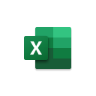
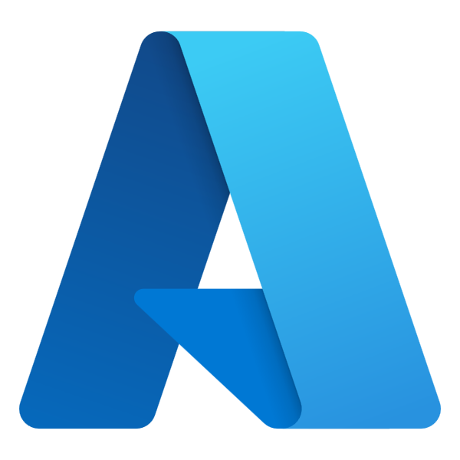
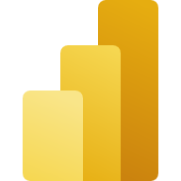
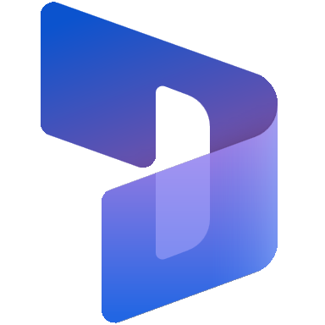
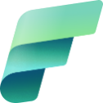
Data Factory
in Microsoft Fabric
Microsoft Azure
Microsoft Fabric
Enterprise data integration in Azure
Self-service data prep with Power Query
Data Factory in Microsoft Fabric
Azure Data Factory
Synapse Link
Purview Integrated
Excel
Power BI
Office 365
Dynamics
Power Platform
Integrated SAAS platform
No-code & code tools
Copilot & AI-powered
Open Source
Notes:
Data Factory in Fabric is built on the unification of Azure Data Factory….our Pro Data integration capability in Azure….
and Power Query…our self service data preparation capability embedded into Power BI, Excel, Dynamics and Power Platform.
Fabric Data Factory offers both low code and pro code approaches to data integration.
Fabric Data Factory is AI Powered through Copilots.
Fabric Data Factory integrates Open Source Data integration approaches.

Slide 10

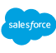




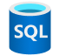



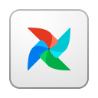

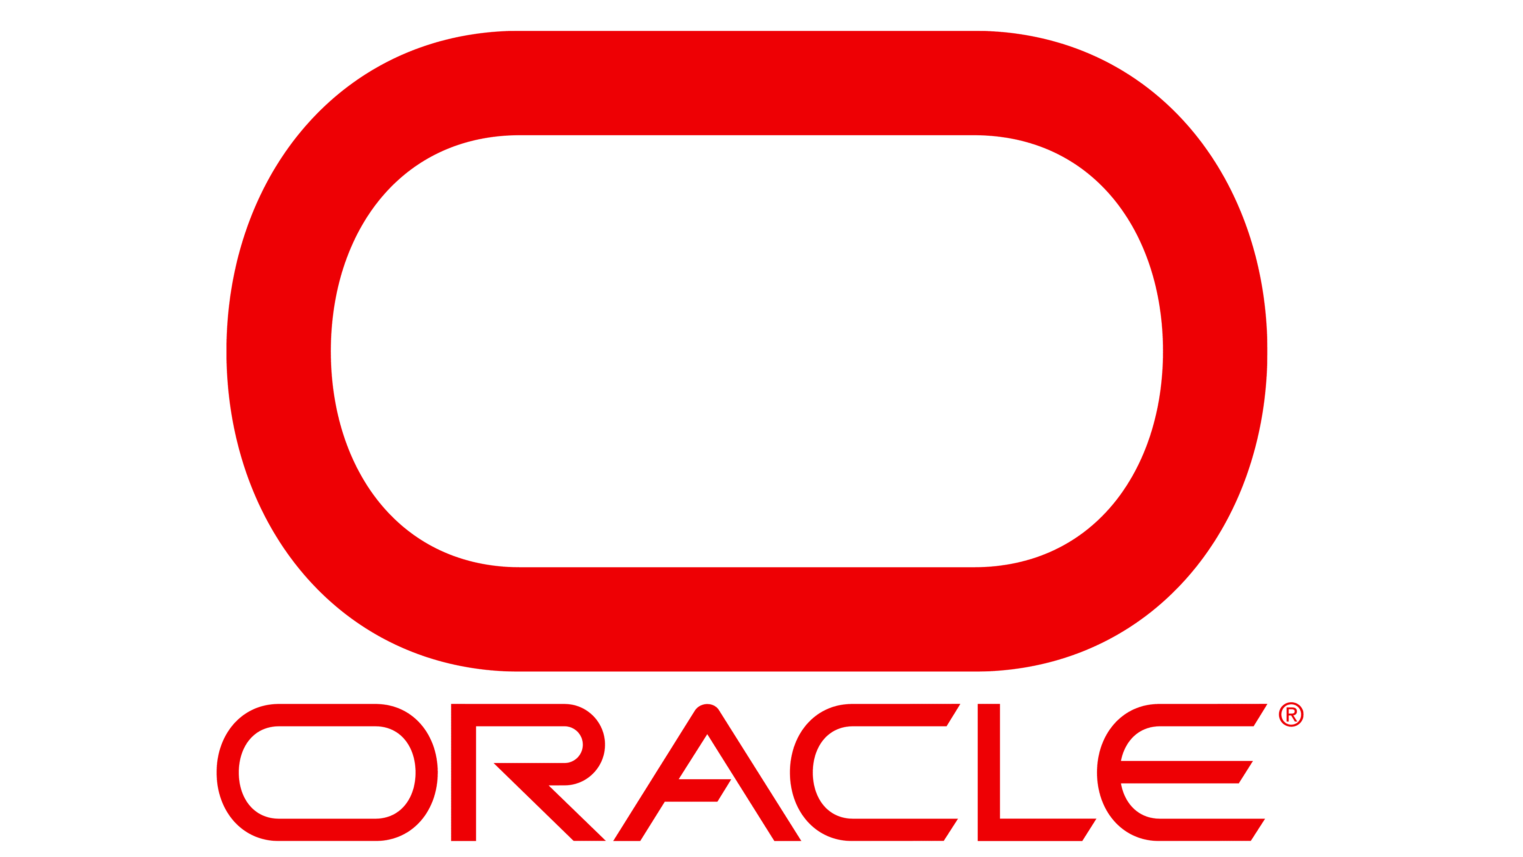
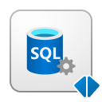
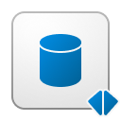


Data Factory
in Microsoft Fabric
Data Movement
Orchestration
Best-in-class Connectivity
Transformation
Deployment & Observability
OneLake
AI-powered Intelligence
Notes:
Let’s look at how Data Factory supports all major data integration critical capabilities –
Data Factory offers best in class connectivity – through hundreds of connectors to business critical data sources, allowing unhindered access to data sources no matter where they reside (be it on-prem, in the cloud or behind virtual networks and firewalls)
Data Factory includes petabyte scale data movement, that is built on Azure Data Factory’s proven capability that is used to move hundreds of petabytes every month.
Data Factory includes Orchestration – also built on Azure Data Factory’s industry leading orchestration capabilities – currently responsible for running 10s of billions of orchestrations per month.
Data Factory includes Transformation capabilities that are built in industry leading data preparation experiences provided by Power Query, that is now delivering transformations at enterprise scale via Fabric Compute engines.
Deployment, DevOps and observability are built in to Data Factory as part of a complete data management and integration platform.
Data Factory is built on top of OneLake, with AI built in.

Slide 11




Data Factory
in Microsoft Fabric
Items in Microsoft Fabric
Pipeline
Dataflow Gen2
Mirrored Database
Ingest data at scale and schedule data workflows.
Prep, clean, and transform data.
Easily replicate data from an existing source into Onelake.
Copy Job
Apache Airflow Job
Azure Data Factory
Copy data easily with settings for full, incremental, or event-based.
Simplify creation and management of Apache Airflow environments.
Link ADF into Fabric, and be able to use all your ADF pipelines in Fabric
Notes:
Wilson
Let’s look at how Data Factory supports all major data integration critical capabilities

Slide 12
Data Factory
in Microsoft Fabric
Items in Microsoft Fabric
Pipeline
Dataflow Gen2
Ingest data at scale and schedule data workflows.
Prep, clean, and transform data.
Copy Job
Mirrored Database
Copy data easily with settings for full, incremental, or event-based.
Easily replicate data from an existing source into Onelake.
Notes:
Wilson

Slide 13
Data Factory
in Microsoft Fabric
Items in Microsoft Fabric
Pipeline
Dataflow Gen2
Ingest data at scale and schedule data workflows.
Prep, clean, and transform data.
Copy Job
Mirrored Database
Copy data easily with settings for full, incremental, or event-based.
Easily replicate data from an existing source into Onelake.
Notes:
Wilson

Slide 14
Data Factory
in Microsoft Fabric
Items in Microsoft Fabric
Pipeline
Dataflow Gen2
Ingest data at scale and schedule data workflows.
Prep, clean, and transform data.
Copy Job
Mirrored Database
Copy data easily with settings for full, incremental, or event-based.
Easily replicate data from an existing source into Onelake.
Notes:
Wilson

Slide 15
Data Factory
in Microsoft Fabric
Items in Microsoft Fabric
Pipeline
Dataflow Gen2
Ingest data at scale and schedule data workflows.
Prep, clean, and transform data.
Copy Job
Mirrored Database
Copy data easily with settings for full, incremental, or event-based.
Easily replicate data from an existing source into Onelake.
Notes:
Wilson

Slide 16
Data Factory
in Microsoft Fabric
Items in Microsoft Fabric
Pipeline
Dataflow Gen2
Ingest data at scale and schedule data workflows.
Prep, clean, and transform data.
Copy Job
Mirrored Database
Copy data easily with settings for full, incremental, or event-based.
Easily replicate data from an existing source into Onelake.
Notes:
Wilson

Slide 17

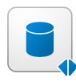
Database Mirroring Deep-Dive
Notes:
Shireen

Slide 18
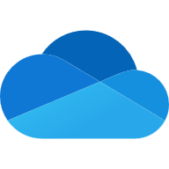

OneLake for all data
“The OneDrive for data”
OneDrive
for documents
OneLake
for data
OneLake provides a data lake as a service without you needing to build it
Notes:
OneLake aims to provide you a data lake as service without you needing to build it yourself. OneLake is your organization’s single unified multi-cloud SaaS data lake eliminating data duplication and integration tax. For years, you have had “OneDrive” for all your documents. Now, you have “OneLake” for all your data.
With OneLake, Fabric’s unified data lake, you can create a truly AI-powered data estate to fuel your AI innovation and data culture. OneLake is built to span an entire organization with domains and workspaces that can help you organize your data into a logical data mesh. OneLake’s shortcuts and mirroring capabilities enable you to access your entire multi-cloud data estate from a single, intuitively organized data lake. With your data in OneLake, you can then work from a single copy across analytics engines, whether you are using Spark, T-SQL, KQL, or Analysis Services and even access that data from other apps like Microsoft Excel or Teams.

Slide 19

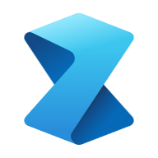

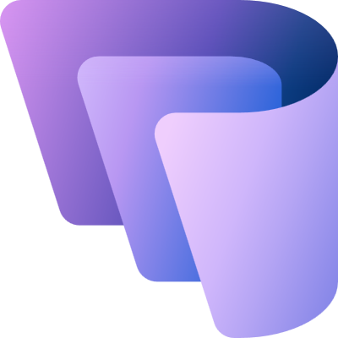




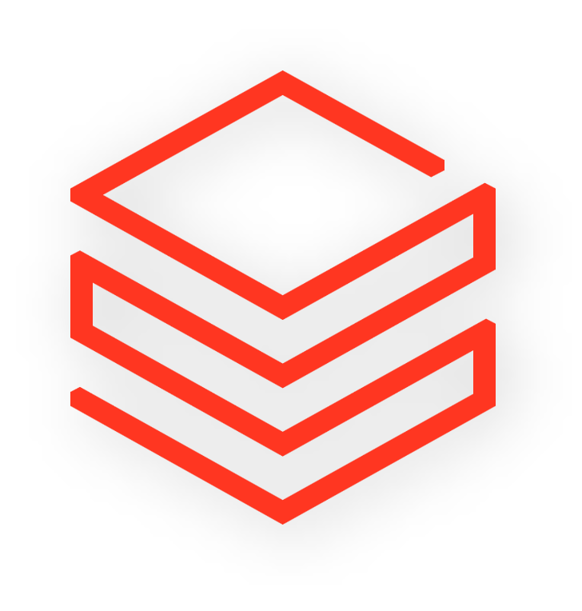



Unifying data in OneLake
Cross-cloud shortcuts & mirroring
First multi-cloud SaaS data lake
Shortcuts for existing data cross clouds and on-premises
Mirroring to add whole databases into the OneLake data estate
Data
Factory
Data
Engineering
Data
Science
Data Warehouse
Databases
Real-Time Intelligence
Power BI
OneLake
Azure
AWS S3
GCP
Dataverse
Databricks
Snowflake
On-Prem
Cross Tenant
Notes:
Now we are announcing Dataverse shortcuts, work with all your dynamics data in OneLake, no data movement necessary

Slide 20
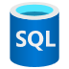

Mirroring in Microsoft Fabric
A mirrored item reflects a full external database in OneLake.
Fabric compute engines
Microsoft Fabric
Ensures the entire database shows up in OneLake, reflecting all changes to the schema and data.
Mirroring
Data
Factory
Data
Engineering
Data Science
Data Warehousing
Databases
Real-Time Intelligence
Power BI
Spark
T-SQL
Serverless
Compute
KQL
Analysis Services
Mirroring can be done through CDC based replication for proprietary formats or by automatically maintaining a set of shortcuts to the external database for open table formats (delta and iceberg)
Azure SQL DB
Azure COSMOS DB
Azure Databricks
Customer 360
OneLake
Service Telemetry
Business KPIs
Metadata only
Finance
Also, Snowflake and other sources…
Notes:
Mirroring in Microsoft Fabric is designed to help you reflect your entire external database into OneLake.
It does not only to help you bring the initial data, but also it keeps all the changes up-to-date reflected into OneLake.
Mirroring can be done through CDC based replication – which we called database mirroring where we physically replicate data from your source like Snowflake, Azure SQL DB, and Cosmos DB mirroring into OneLake where we keep it up to date
We have another type of mirroring, where we synchronize metadata instead of replicating the data. For example, Mirroring for Azure databricks, we will synchronize catalog names, schemas, table definitions and create shortcuts under neath the hood in Fabric

Slide 21

Database Mirroring
Mirrored Database
Mirroring allows you to add whole databases into the OneLake data estate
Setting up mirroring is trivial, the mirrored data is automatically kept up-to-date at near-real-time
Mirroring is FREE*
Landing Zone
CDC Processing
Tables
Connector
CDC feed
Source DB
Notes:
Shireen
So let’s dive a bit deeper into the architecture of Database mirroring, and this valid for all of our connectors that are in preview – Snowflake, Azure SQL, and Cosmos DB.
So the bottom you will see the source DB, and we have our in-built replication engine that first replicates the entire source database into Fabric – basically an initial snapshot of the tables. After that, our engine uses change data feed, such as any inserts, deletes, and updates, and they will be continuously replicated over using the replicator technology into the lakehouse.
And once data is replicated in the OneLake, you can utilize all the capabilities of Fabric, such as running notebooks, data engineering, running Spark queries, and creating power BI reports.

Slide 22
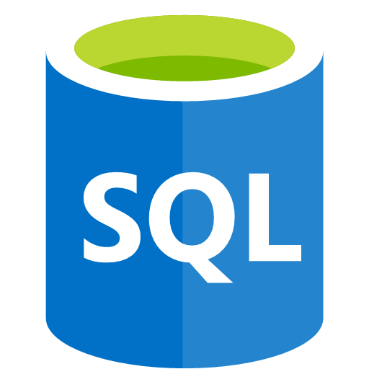

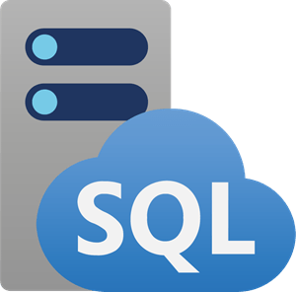

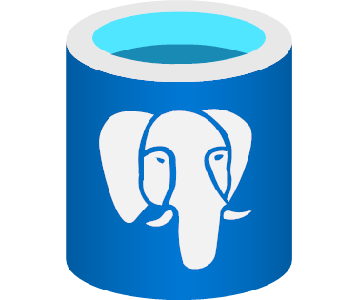

Database Mirroring in Fabric
Automatically reflect data into OneLake
Snowflake
Mirroring for Snowflake
Mirroring for Azure SQL DB
Mirroring for
Cosmos DB
Mirroring for Azure SQL MI
Mirrored Azure Databricks Catalog
Coming Soon
Mirroring for SQL Server
Mirroring for SQL Server 2025
Mirroring for Azure PostgreSQL
Mirroring for Oracle
Notes:
We have broad support for all the major databases with Mirroring – including Snowflake, Cosmos DB, Azure SQL DB and more.

Slide 23
Free Mirroring Storage for Replicas
OneLake

Slide 24
Transform data using Spark and SQL

Slide 25
Query data using Fabric Data Agents and interact with OneLake

Slide 26
Monitoring, admin, capacities and automation

Slide 27
Wrap up and Q&A

